Slide 1
Agricultural Revocation - About TSSA
June 1, 2021

Slide 2
OUTLINE
Introduction to TSSA
Minister’s Order Revocation
What does this Compliance mean to Agricultural Organizations
Regulatory Hierarchy

Slide 3
GENERAL INFORMATION: DISCLAIMER
This presentation is intended to provide guidance to individuals in the Agricultural industry that own/operate Boilers, Pressure Vessels and Pressure Piping. While efforts have been made to present current, accurate and pertinent information, this presentation is not intended to be a complete reference manual for guiding the actions of individuals working on issues relating to Boiler, Pressure Vessel and Pressure Piping Code compliance. Before applying the information in this presentation, users must weigh its applicability against the particular and unique circumstances of each situation, as well as any other relevant policies or guidelines including the CSA B51 Boiler, Pressure Vessel and Pressure Piping Code and its referenced Codes and Standards, including NBIC. TSSA is not responsible for any actions or omissions by users of this manual, or for the use of or reliance on the information contained in this presentation, or for errors or omissions relating to the contents of this presentation.

Slide 4
GENERAL INFORMATION: DISCLAIMER
Copyright Statement
© Technical Standards and Safety Authority – TSSA (2003). All right reserved. No part of this publication may be reproduced, stored in a retrieval system, or transmitted or published in any form or by any means without the prior written permission of the Technical Standards and Safety Authority.

Slide 5
SECTION 1
Introduction to
TSSA

Slide 6
ABOUT: TECHNICAL STANDARDS AND SAFETY AUTHORITY (TSSA)
Established as a not-for-profit, self-funded organization in 1997, TSSA is delegated by the Government of Ontario to promote and enforce safety in the following sectors:
  amusement devices, elevating devices, and ski lifts;
  boilers, pressure vessels, and operating engineers;
  fuels such as propane, natural gas and fuel oil.
TSSA reports to the Ministry of Government and Consumer Services (MGCS), which oversees TSSA’s delivery of safety services and organizational performance, and retains authority for the Technical Standards and Safety Act, 2000.

Slide 7
ABOUT: TSSA
TSSA oversees the workers, sites and devices regulated under the Technical Standards and Safety Act, 2000 (the Act) and is accountable for administering its public safety mandate to the Ontario government, the residents of Ontario, and the industries it regulates.
By monitoring incidents to identify areas of risk by leveraging the expertise of its employees, external experts and stakeholders, TSSA designs and delivers safety programs and services to reduce the likelihood of injury to Ontarians.
TSSA is governed by a 13-member Board of Directors, composed of seven elected and six members appointed by the Minister of Government and Consumer Services.

Slide 8
ABOUT: TSSA
Range of safety services include:
    public education and consumer information,
    certification, licensing and registration,
    data analytics, risk evaluation
    engineering design review,
    inspections, investigations,
    compliance support,
    safety management consultation, and
    enforcement and prosecution activities.
    TSSA also provides limited non-regulatory services through contracts to organizations, mainly in the nuclear industry.

Slide 9
ABOUT: TSSA
Our Purpose: To enhance safety where Ontarians live, work and play.
Our Vision: To be a valued authority for a safer Ontario.
www.tssa.org

Slide 10
LAWS ADMINISTERED BY TSSA
TSSA administers and enforces the Technical Standards and Safety Act, 2000 (the Act) and its associated regulations for the Province of Ontario.
Amusement Devices Regulation
Certification & Training of Amusement Device Mechanics Regulation
Boilers & Pressure Vessels Regulation
Elevating Devices Regulation
Certification & Training of Elevating
Devices Mechanics Regulation
Compressed Gas Regulation
Fuel Oil Regulation
Gaseous Fuels Regulation
Liquid Fuels Regulation
Oil & Gas Pipeline Systems Regulation
Propane Storage and Handling Regulation
Liability Insurance Requirements for Propane Operators Regulation
Certification of Petroleum Equipment Mechanics Regulation
Fuel Industry Certificates Regulation
Operating Engineers Regulation

Slide 11
LAWS ADMINISTERED BY TSSA
TSSA administers and enforces the Technical Standards and Safety Act, 2000 (the Act) and its associated regulations for the Province of Ontario.
Boilers & Pressure Vessels & Operating Engineers
  O.Reg 220/01: Boilers & Pressure Vessels
  O.Reg 219/01: Operating Engineers

Slide 12
LAWS ADMINISTERED BY TSSA
Elevating and Amusement Devices
  O.Reg 221/01: Amusement Devices
    O.Reg 187/03: Certification & Training of Amusement Device Mechanics
  O.Reg 209/01: Elevating Devices
    O.Reg 222/01: Certification and Training of Elevating Device Mechanics

Slide 13
LAWS ADMINISTERED BY TSSA
Fuels
  O.Reg 214/01: Compressed Gas
  O.Reg 213/01: Fuel Oil
  O.Reg 212/01: Gaseous Fuels
  O.Reg 217/01: Liquid Fuels
  O.Reg 210/01: Oil and Gas Pipeline Systems
  O.Reg 211/01: Propane Storage & Handling
  O.Reg 197/14 - Liability Insurance Requirements for Propane Operators
  O.Reg 216/01: Certification of Petroleum Equipment Mechanics
  O.Reg 215/01: Fuel Industry Certificates

Slide 14
Agricultural Contact Email
Below is the email address that can be used to ask TSSA questions about the requirements for agricultural sites:
agriculture.bpv@tssa.org
Below is a link to the Agriculture section of the TSSA Website:
Agricultural Use - Boilers and Pressure Equipment - TSSA

Slide 15
SECTION 2
Minister’s Order Revocation

Slide 16
MINISTER’S ORDER REVOCATION
Link to Minister’s Revocation

Slide 17
MINISTER’S ORDER REVOCATION - SUMMARY
The BPV Regulation came into effect June 27, 2001.
A Minister’s Order was issued on June 27, 2001 to exempt Agricultural equipment.
The Minister’s Exemption – Revocation was signed July 17, 2020.
The Revocation became effective on July 1, 2021.

Slide 18
SECTION 3
What does this Compliance mean to Agricultural Organizations

Slide 19
WHAT DOES THIS COMPLIANCE MEAN?
Compliance to Ontario Regulation 220/01 means that all Boilers, Pressure Vessels & Piping going forward that fall under the 220/01 Regulation

Slide 20

Key areas to be reviewed in this section
What are your requirements for the items below:
Existing Boilers and Pressure Vessels
Repairs to Boilers and Pressure Vessels
Alterations to Boilers and Pressure Vessels
New Piping installations
Working on existing Piping systems
Additions or modifications to Piping systems
The other presentations will go over these items in detail.

Slide 21
What is needed for my existing Boilers and Pressure Vessels
TSSA inspectors will inspect existing equipment for Critical Safety Factors. The critical safety factors will be used to evaluate existing equipment that have been in operation prior to the Agricultural Revocation.
For devices that existing prior to the revocation, TSSA will perform a first inspection and identify risks to safety.
For devices that are installed after July 1, 2021, a TSSA Inspector is required to complete a First Inspection of the Boiler or Pressure Vessel.
A “Certificate of Inspection” will be issued for each Boiler or Pressure Vessel that TSSA inspects.
Boilers & Pressure Vessels will require Periodic Inspections. If the devices are covered under a Boiler Machinery Breakdown coverage, then an Insurance Inspector will conduct the periodic inspections; otherwise, a TSSA Inspector will perform the periodic. The intervals for periodics are set forth by the TSSA Code Adoption Document.

Slide 22
What is needed to repair my Boilers and Pressure Vessels?
Any welded repairs to the pressure boundary of a Boiler or Pressure Vessel are required to be completed by a Certified Repair/Alteration Organization with Certification from the National Board or TSSA to complete such a Repair.
NOTE: Repair Organizations shall provide proof of Certification to the Insurance Inspector or TSSA Inspector.
The Insurance Inspector or TSSA Inspector shall be notified by the Repair Organization prior to initiating the repair.
The Insurance Inspector or TSSA Inspector will perform inspections as required.
A TSSA Report of Repair or Alteration, completed and signed by the Repair Organization and Inspector shall be maintained on file by the Owner.

Slide 23
What is needed to alter my Boiler or Pressure Vessels?
Any Alterations to a Boiler or Pressure Vessel is required to be completed by a Certified Alteration Organization with Certification from the National Board or TSSA to complete such an Alteration.
  NOTE: Alteration Organizations shall provide proof of Certification to the TSSA Inspector.
Alterations shall be registered with TSSA BPV Engineering. An Alteration Number will be given by the TSSA.
Alterations can only be inspected by a TSSA Inspector.
A TSSA Report of Repair or Alteration, completed and signed by the Alteration Organization and Inspector shall be maintained on file by the Owner.

Slide 24
What is needed to install new piping systems?
New Piping Systems are required to be registered with TSSA BPV Engineering.
Companies installing piping are required to have a Certificate of Authorization from TSSA or another Canadian jurisdiction.
Piping Systems are required to be inspected by a TSSA Inspector, prior to being put in service.
The TSSA Inspector shall be contacted prior to initiation of work to ensure all requirements are addressed.

Slide 25
What is needed to work on existing piping systems?
Definition of Repair:
  Repairs include any work that is required to restore equipment to a safe operating condition that does not deviate from the original design. Like for like components.
The TSSA Inspector shall be contacted prior to initiation of work to ensure all requirements are addressed.
Piping Repairs will need to match the “as built” condition.
Repairs to Piping Systems are required to be inspected by a TSSA Inspector, prior to putting the equipment back in service.

Slide 26
What is needed to add or modify a piping system?
Definition of Alteration:
  Alterations are any changes that deviate from the original design and require design calculations that could affect pressure-containing capability.
Alterations to Piping Systems are required to be registered with TSSA BPV Engineering.
Companies installing piping are required to have a Certificate of Authorization from TSSA or another Canadian jurisdiction.
Piping Systems are required to be inspected by a TSSA Inspector, prior to being put in service.
The TSSA Inspector shall be contacted prior to initiation of work to ensure all requirements are addressed.

Slide 27
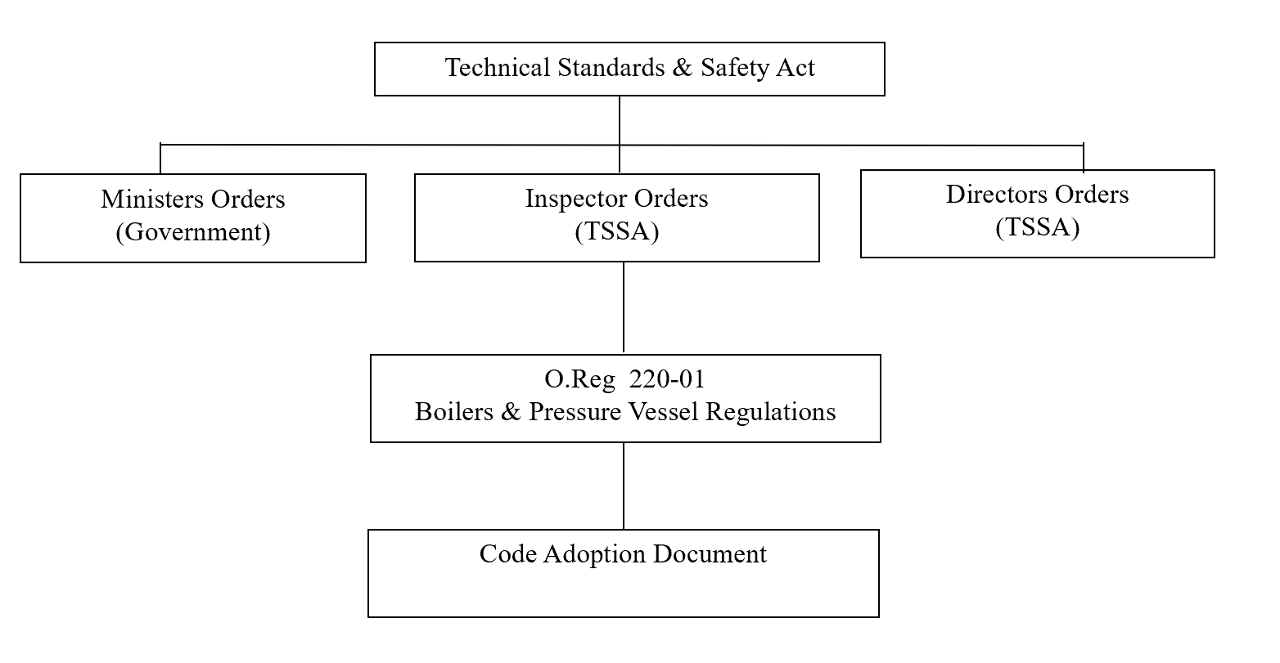
SECTION 4
REGULATORY HIERARCHY

Slide 28
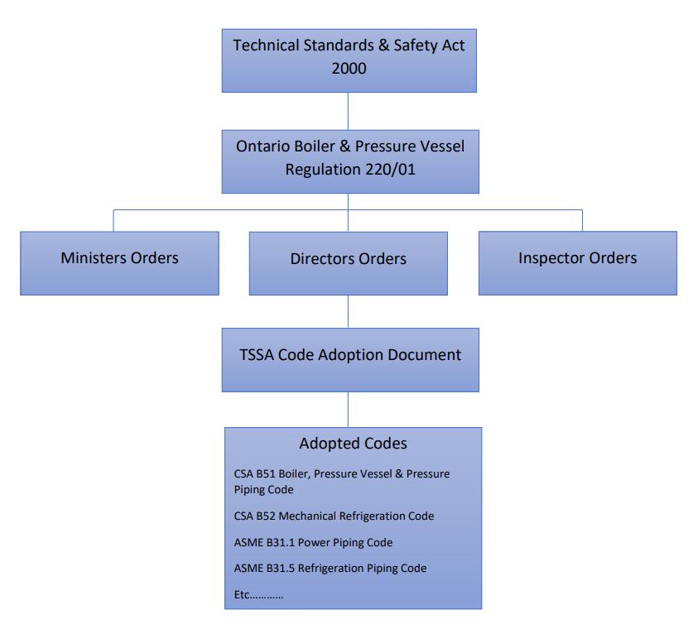
HIERARCHY OF REGULATORY REQUIREMENTS

Slide 29
Description of various regulatory documents
WHAT IS THE TECHNICAL STANDARDS & SAFETY ACT?
The Act is a Government of Ontario document that establishes general principles, duties and responsibilities as well as defines the administrative powers for monitoring, enforcing and creating regulations.
WHAT ARE THE BPV REGULATIONS?
More specific provisions, responsive to the unique needs of the sector including
Is controlled by review with MCS (Ministry of Government and Consumer Services) as changes to Codes and Standards take place
Authorizations to carry out specific duties
Powers of inspectors
Appeal mechanisms
Regulation-making authority
Procedures and requirements for licenses
Duties of contractors
Requirements for registering new and altered B & PV
Operation and Maintenance requirements
Record keeping requirements
A document referenced by the Boilers and Pressure Vessel Regulation
Provides the Codes and Standards to be used for compliance with the Regulation
Allow TSSA to accept and amend codes and standards without a regulatory change.
WHAT IS THE CODE ADOPTION DOCUMENT (CAD)?

Slide 30
RESPONSIBILITIES
DESIGN
Owners are responsible for purchasing equipment that have CRNs, this ensures the design was reviewed by TSSA.
Manufacturers and contractors are typically the groups that register designs of pressure equipment with TSSA.
TSSA conducts an independent design review for code compliance.
The boiler, pressure vessel, fitting and piping designs are required to be registered before fabrication or installation.

Slide 31
RESPONSIBILITIES
FABRICATION AND INSTALLATION
  Owners and users are responsible for contacting TSSA prior to installation of equipment to arrange inspections.
  Manufacturers and contractors are responsible for contacting TSSA prior to starting fabrication.
  For new equipment, we inspect boilers and pressure vessels during fabrication process.
  TSSA also inspects piping installations during construction
  Owners can find Authorized contractors by visiting our site:
    TSSA - Certificate Business Directory

Slide 32
RESPONSIBILITIES
  FABRICATION AND INSTALLATION (CONT’D)
  TSSA reviews and audits quality systems of manufacturers of pressure equipment and piping contractors.
  Authorization certificates are issued by TSSA to manufacturers and piping contractors for successfully completing the quality system audit.
  Owners, operators and contractors cannot perform work on devices that are under the regulation if you do not have a valid Certificate of Authorization.

Slide 33
RESPONSIBILITIES
  WELDING AND BRAZING PROCEDURES
  Fabricators and manufacturers are responsible for using registered welding and brazing procedures along with qualified welders and brazers.
  Welding and brazing procedures are reviewed by TSSA for compliance with codes and standards.
  Registration numbers are issued for accepted welding and brazing procedures.

Slide 34
RESPONSIBILITIES
  WELDERS AND BRAZERS
  TSSA test welders and brazers, using welding and brazing procedures registered with TSSA by the employer or training institutions.
  Certificates are issued to welders and brazers who have successfully completed the tests.
  Contact your local inspector or TSSA’s office to get your welders and brazers tested. The inspector Directory can be found below:
    Inspections - TSSA

Slide 35
RESPONSIBILITIES
  OPERATION
  Owners and users are responsible for ensuring equipment has valid certificates of inspection (COI) for operation.
  TSSA inspects uninsured boilers and pressure vessels at specific intervals. Note: for insured equipment, contact your insurance company.
  TSSA and Insurers can conduct boilers and pressure vessel repair inspections.
  TSSA conducts boiler and pressure vessel alteration inspections.

Slide 36
Thank You
for Attending TSSA’s Ontario Regulations Overview Seminar

