Slide 1
Agricultural Revocation - Equipment Installed prior to July 1, 2021
June 1, 2021

Slide 2
Summary
This presentation will cover the items listed below:
  Rules for equipment that have been in operation prior to July 1, 2021.
  Performing work on piping systems.
  The maintenance requirements for regulated devices.
  Relief Valve servicing and lift testing

Slide 3
GENERAL INFORMATION: DISCLAIMER
This presentation is intended to provide guidance to individuals in the Agricultural industry that own/operate Boilers, Pressure Vessels and Pressure Piping. While efforts have been made to present current, accurate and pertinent information, this presentation is not intended to be a complete reference manual for guiding the actions of individuals working on issues relating to Boiler, Pressure Vessel and Pressure Piping Code compliance. Before applying the information in this presentation, users must weigh its applicability against the particular and unique circumstances of each situation, as well as any other relevant policies or guidelines including the CSA B51 Boiler, Pressure Vessel and Pressure Piping Code and its referenced Codes and Standards, including NBIC. TSSA is not responsible for any actions or omissions by users of this manual, or for the use of or reliance on the information contained in this presentation, or for errors or omissions relating to the contents of this presentation.

Slide 4
GENERAL INFORMATION: DISCLAIMER
Copyright Statement
© Technical Standards and Safety Authority – TSSA (2003). All right reserved. No part of this publication may be reproduced, stored in a retrieval system, or transmitted or published in any form or by any means without the prior written permission of the Technical Standards and Safety Authority.

Slide 5
OUTLINE
Previously existing Boiler, Pressure Vessels and Piping
Maintenance Requirements

Slide 6
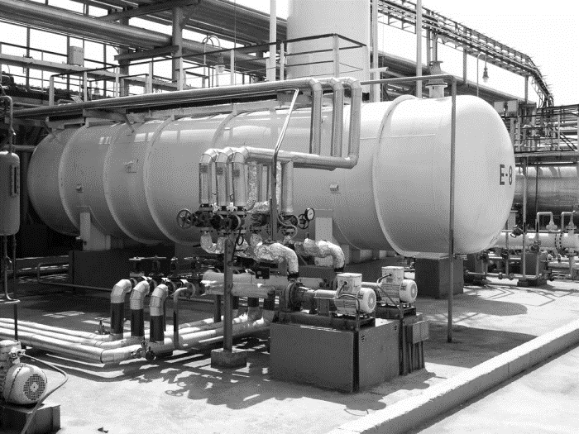
SECTION 1
Previously Existing Boilers, Pressure Vessels & Piping

Slide 7

PREVIOUSLY EXISTING / INSTALLED:
BOILERS & PRESSURE VESSELS
TSSA will complete a First Inspection of Boilers & Pressure Vessels installed prior to July 1, 2021.
The purpose of the First Inspection is to determine if the Boilers & Pressure Vessels are in SAFE operating condition and safety devices are installed, of adequate size, and are maintained.
TSSA will use Critical Safety Factors to evaluate the safety of the installed devices.
The TSSA will enter in a database the Boilers and Pressure Vessels found operating in the Province. We will not “Register” piping systems.
The Certificate of Inspection (COI) will be issued after the First Inspection.
The expiration of the COI will relate to the date of the First Inspection.

Slide 8
PREVIOUSLY INSTALLED EXISTING: PIPING SYSTEMS PART 1
The requirement to register Piping systems started in 1970.
We understand there are existing piping systems have been installed prior to the Agricultural Revocation. Existing piping will be reviewed for Critical Safety Factors.
Systems that were put into service prior to the Agricultural Revocation will not need to be registered to continue to operate.

Slide 9
Working on Existing Piping Systems
No changes
No changes: to service fluid, increase to maximum operating pressure or operating temperature, overpressure protection arrangement, no energy source added (heat exchanger, boiler, pump, compressor)
The piping repair specification is applicable so no engineering review would be needed.
All other
All other work will require design registration of impacted portion, inspection by TSSA inspector and contractor performing work will need to have appropriate Certificate of Authorization.
Like-for-like Replacement
Without welding or brazing can be considered mechanical repairs.
For details see SAFETY INFORMATION BULLETIN: SB05-01 - Guideline for Maintenance Replacement of Mechanically Assembled Items in Existing Pressure Piping Systems.
For this type of work, none of the following is required: design registration, contractor with a CofA and inspection by TSSA.
Inspection by TSSA inspector is required and contractor performing work will need to have appropriate Certificate of Authorization.

Slide 10
TSSA Inspector enrolment
Please contact your local inspector prior to starting your repair. The inspector can review if you have properly identified this system as under the Regulation.
A TSSA inspector may visit the site a few times to review the materials piping and fittings that will be installed in the system.
The TSSA inspector will also go to site at the end of the job to “witness” the Pressure test
The contractor performing the work will contact TSSA to schedule the inspections as needed.
The contractor will be required to have a Certificate of Authorization for Repairs from TSSA or a Certification from the National Board to perform the repair.

Slide 11
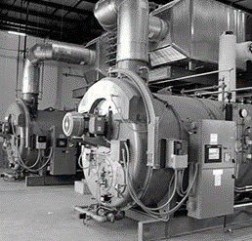
SECTION 2
Maintenance Requirements

Slide 12
Relief Valve Servicing Intervals - General
The Code Adoption Document (CAD) documents the servicing interval for Pressure Relief Devices in section 1.40 on Page 16 of 33.
There are many different types of pressure devices and they have different servicing rules.
Owners should document the lift testing that they perform.
Other pressure vessels and piping systems not in the next two slides, including boilers other than steam or hot water service, shall have the Relief Valve serviced every 3 years.
Servicing of Relief valves can only be done by companies holding a COA from TSSA or a Certificate from ASME.
When Relief Valves are replaced, they need to be ASME compliant devices that do not exceed the Maximum Allowable Working Pressure of the equipment.

Slide 13
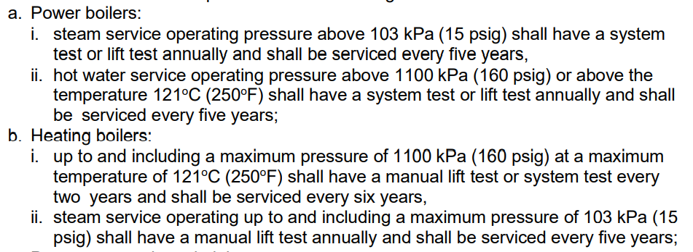
Relief Valve Servicing Intervals
Power Boilers and Heating Boilers

Slide 14
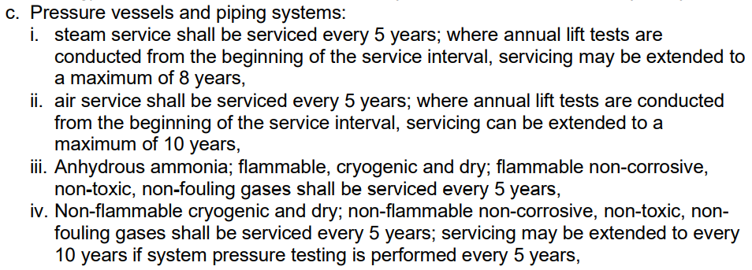
Relief Valve Servicing Intervals
Pressure Vessels and Piping Systems

Slide 15
Periodic Inspection - General
When an Owner has Boiler Machinery Breakdown Coverage, the periodic Inspections are conducted by the Insurer.
When an owner does not have Boiler Machinery Breakdown Coverage, TSSA will perform the periodic Inspections.
Owners are required to request periodic inspections.
Certificates of Inspection are issued upon completion of periodic Inspections.
Contact your local inspector to know what needs to be done in preparation for a periodic inspection. Example: internal inspection and boiler controls.

Slide 16
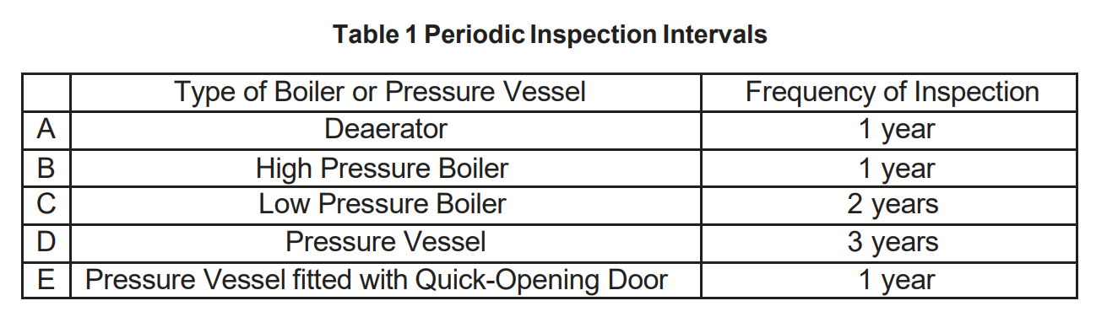
Periodic Inspection - Intervals
The interval for periodic inspections are captured in the Section 5.2 of the Code Adoption Document (CAD)
During periodic inspections, boiler controls will have to be demonstrated and in good working condition.

Slide 17
Thank You
for Attending TSSA’s Ontario Regulations Overview Seminar

